Slide 1
C300 Final-Term Evaluation
Team ID:
SOI-2021-0006
Team Members:
1. Tze Yang
2. Stephen
3. Justin
4. Gabriel
Project ID:
SOI-2021-2110-0063
Project Title:
Wound Image Repository

Slide 2


Introduction
The project is about an Image Wound Repository that collects wound images from various sources. The images will then be added to a repository where users are allowed to upload their wound, mask, and annotation images where they can label the following Metadata parameters:
Wound Category, Wound Stage, Wound Location and Tissue types.
In which the users can also view wounds, search wounds and view a dashboard of the overall summary of the wounds.

Slide 3
Major Requirements
User can create wound record that allow user to upload single wound, mask and annotation images and enter required metadata
View the details of specific wound record
Upload and delete additional annotation and mask image
Edit metadata of wound record
Wound Record can be search by its metadata
Allow user to delete wound record that is created
Provide a zoom function of the wounds
Provide a dashboard of the wound data

Slide 4
Application Implementation & Process
MVC architecture is implemented throughout the project known as Model-View-Controller (MVC), a structural design that isolates an application into three primary consistent components: Model, View, Controller.
Model – Manages System Data
View – Defines and manages how data is presented to user
Controller – Manages User Interaction

Slide 5
Application Function & Design
Doctor
Login User
View Wounds
Search Wounds
View Dashboard
Annotator
Login User
View Wounds
Create, Edit, and Delete Wounds, Annotations, and Metadata
Search Wounds
View Dashboard
Admin
Register User
Login User
View Wounds
Add, Edit, and Delete Wounds, Annotations, and Metadata
Add, Edit, and Delete Wound Metadata
Search Wounds
Manage and Add New User Accounts
View Dashboard

Slide 6
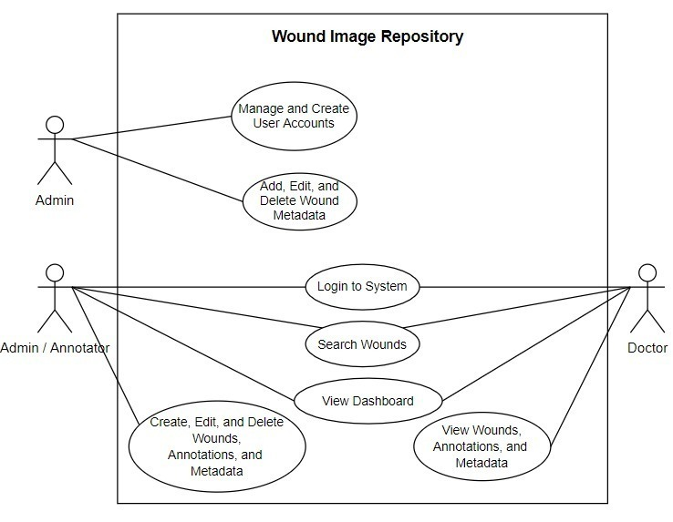
Application Function & Design

Slide 7
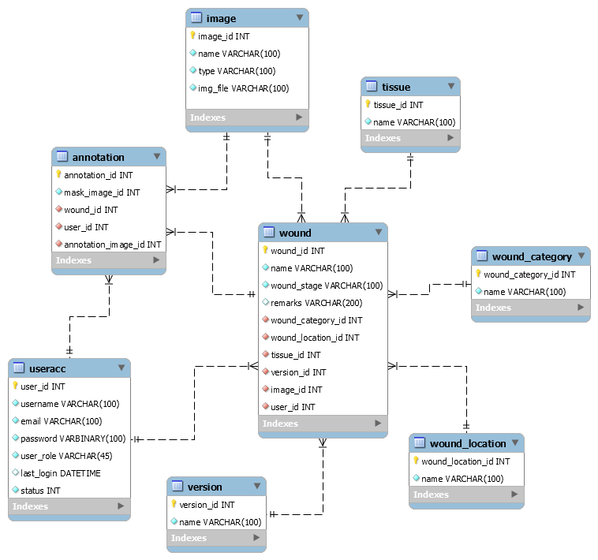
Application Function & Design

Slide 8
Application Function & Design
Create
Check input validity
Retrieve properties of from the database (wound category, version and tissue) as dropdown field
Call the upload file method 'DoPhotoUpload' to get string of annotation and mask image
Insert properties into database table (image, wound location, wound, annotation)
Details
Get the list of selected wound record
Add the elements of annotation list to the list of wound record
Return the object to view page and display output
UpdateAnnotationAndMaskImage
Call the upload file method 'DoPhotoUpload' to get string of annotation and mask image
Insert properties of annotation and mask image into image and annotation table
Display the additional annotation and mask image

Slide 9
Application Function & Design
Update
Retrieve properties from the database (wound category, version and tissue) as dropdown field
Display the selected wound record
Check input validity
Update metadata properties into database table
Display the updated wound record
DeleteAnnotationMaskImage
Get the selected annotation and mask image
Delete from the database (annotation, image)
Redirect to the view page
PreviousOrNextWound
Get the list of wound record
Check if there is any valid wound record exist in the next or previous page
Get the wound record and display the output

Slide 10
Application Function & Design
Userlist
Retrieve properties from the database (useracc) and put them in a list
Display them into the table
EditUser
Check input validity
Retrieve properties of from the database (useracc) and replace the details accordingly
Bring the user back to Userlist
Registry
Check input validity
Inject the new record users into the database
Bring the user back to Userlist

Slide 11
Metadata Functions
AddVersion, AddWoundCateogry, AddTissue
Get the selected metadata from the database
Check input validity
Insert the metadata (Version, Wound Category, Tissue) into the database
Display the metadata that is added
EditVersion, EditWoundCateogry, EditTissue
Get the selected metadata from the database
Check input validity
Update the metadata (Version, Wound Category, Tissue) from the database
Display the updated metadata
DeleteVersion, DeleteWoundCategory, DeleteTissue
Get the selected metadata from the database
Check input validity
Delete the metadata (Version, Wound Category, Tissue) from the database
Redirect to the view page

Slide 12

Testing of the End Deliverables
Notes:
Unit testing, integration testing... Issues spotted.. Time spent on testing..

Slide 13
Task Allocation : Stephen
Task specification | Associated controller , functions and view
Get Administrators to view and manage users (edit users , delete users , edit the status of users) | AdminController : Userlist , EditUser , Delete , statusedit Views : Userlist , admin
Get system to edit users | AdminController : EditUser Views : EditUser , admin
Allows administrators to register users | AdminController : [HttpPost] Registry Views : Registry , admin
Allows users to log in to the system and recorded log in timing and remember users | AccountController: LoginPage , [HttpPost] LoginPage , AuthenticateUser Views : LoginPage , account

Slide 14
Task Allocation : Stephen
Task specification | Associated controller , functions and view
Get Admins to be able to delete wound records | WoundController : Delete , picturedeletefuntion() Views : (technically displayed on index), wound
Multi delete wound records | WoundController : multi-delete , deletefunction() Views : (function is displayed in index), wound
Filter out records from the entire table | WoundController : Indexpost() Views : (function is displayed in index), wound
Allow users to have a Zoom Image | WoundController : ZoomImage Views : ZoomImage, wound
Filter out and hide columns | (javascrpt controller) Views : Index , wound
Create a password management system for resetting passwords (check password before resetting) | AccountController : resetpw , badPasswords Views : resetpw

Slide 15
Task Allocation – Javascript (Stephen)
Task specification | View name (controller/ view) | Javascript functions
Multi delete wound records | Index/ wound | showhideMultiDeletetwo() ConfirmDelete()
Filter out records from the entire table | (wound/TheWounds) &(Index/ Wound) | showhidesearchfoundry()
Allow users to have a Zoom Image | wound/ZoomImage | ImageZoom()
Filter out and hide columns | Index/ wound | rightbarcheck() openRightMenu() closeRightMenu() addtodeletelist(num) Hidewoundid() Hidename() Hidewoundstage() HideRemarks() HideCategory() HideLocation() HideOriginalWoundImage() HideTissue() HideVersion() HideDetails() HideUsername() editNdelete() HideallCol() ResizeColumn() showhideMultiDeletetwo()

Slide 16
Task Reference : Stephen
​Task specification | ​source
​Filter out and hide columns | ​DataTables example - Hidden columns W3.CSS Sidebar (w3schools.com)
​Allow users to have a Zoom Image | ​How To Create an Image Zoom (w3schools.com)
​Filter out records from the entire table | ​Use JavaScript to Hide or Show a Portion of a Form - YouTube
​Multi delete wound records | JavaScript Arrays (w3schools.com) JavaScript Array Methods (w3schools.com)
​ | ​
​ | ​
​ | ​

Slide 17
Task Allocation : Tze Yang
Task specification | Associated controller , functions and view
Creation of wound record for user to upload images (wound, annotation, mask) and input metadata (Wound Name, Wound Stage, Wound Location, Wound Category, Wound Tissue, Image Version, Remarks) Create a UI for user to create wound record | Controllers: WoundContoller - Create(), [HttpPost] Create(), DoPhotoUpload() - SetWoundCategoryViewData() - SetTissueViewData() - SetVersionViewData() Views: Wound - Create.cshtml
Allow user to view the selected wound record that is created | Controllers: WoundContoller - Details() Views: Wound - Details.cshtml
Allow user to update metadata for the selected wound record | Controllers: WoundContoller - Update(), [HttpPost] Update() - SetWoundCategoryViewData(), SetTissueViewData() Views: Wound - Update.cshtml

Slide 18
Task Allocation : Tze Yang
Task specification | Associated controller , functions and view
Upload additional annotation and mask image for wound record | Controllers:WoundContoller - UpdateAnnotationMaskImage(), DoPhotoUpload() Views: Wound - Details.cshtml
Delete additional annotation and mask image for wound record | Controllers: WoundContoller - DeleteAnnotationMaskImage() Views: Wound - Details.cshtml
Navigate to different wound record page | Controllers: WoundContoller - PreviousOrNextWound(), GetPreviousOrNextWound() Views: Wound - Details.cshtml
Allow user to edit metadata in the database for Image Version, Wound Category and Tissue | Controllers: AdminController - EditVersion(), EditWoundCategory(), EditTissue() Views: Wound - Details.cshtml
Allow user to delete metadata in the database for Image Version, Wound Category and Tissue | Controllers: AdminController - EditVersion(), EditWoundCategory(), EditTissue() Views: Wound - Details.cshtml

Slide 19
Task reference : Tze Yang
​ Task Specification | ​Resources
​Create wound record with image upload and allow user to input metadata, Update metadata, Delete additional annotation and mask image | ​C236 Web application development in .NET
​Learning how to debug code | ​https://docs.microsoft.com/en-us/visualstudio/get-started/csharp/tutorial-debugger?view=vs-2019

Slide 20
Task Allocation : Gabriel
Task specification | Associated controller , functions and view
Develop Project Gantt Chart | -
Develop Use Case Diagram | -
Create and Design Database Model Create SQL ERD Create SQL Script | -
Authenticate and Authorize User Roles Navigate User Roles | Controllers: AccountController, AdminController, ChartController, HomeController, WoundController
Create a Sidebar Layout Overview GUI of the Web Application | Views: _Layout.chsmtl
Allows users to log in to the system and recorded log in timing and remember users | AccountController: LoginPage , [HttpPost] LoginPage , AuthenticateUser Views : LoginPage

Slide 21
Task Allocation : Gabriel
Task specification | Associated controller , functions and view
Allow user to add metadata in the database for Image Version, Wound Category and Tissue | Controllers: AdminController EditVersion(), EditWoundCategory(), EditTissue() Views: Wound - Details.cshtml
View Wound Page specifically for Doctors | Controllers: WoundContoller Details() Views: Wound Details.cshtml, TheWounds.cshtml
Create a password management system for resetting passwords (get users name and ask security question , respectively) | Controllers: AccountContoller Forgetmetwo() , [httpPost]Forgetmetwo() Forgetmeone(), [httpPost]Forgetmeone() Views: Account Forgetmeone.chtml , forgetmetwo.csthml

Slide 22
Task reference : Gabriel
​Task Specification | ​Resources
​Create a Sidebar Layout Overview GUI of the Web Application | ​https://bootsnipp.com/snippets/Q0dAX

Slide 23
Task Allocation : Justin
Task specification | Associated controller , functions and view
Create a datatable view for wounds page | Controller: WoundController, Index() View: Index
Create a page for the wounds | Controller: WoundController, Index() View: Index
Create a main page for the dashboard | Controller: ChartController,Dashboard() View: Dashboard
Create a line Chart to display the names of tissues and the current records | Controller: ChartController, Dashboard(),locateTissues(int) View: Dashboard
Create a bar Chart to display a history of the locations and their current number of records | Controller: ChartController, Dashboard(),PrepareWoundsData(int) View: Dashboard
Create a bar Chart to display the names of the user roles and their current number of records | Controller: ChartController, Dashboard(),DisplayUsers(int) View: Dashboard
Create a pie chart to display the names of the wound categories and the current number of records | Controller: ChartController, Dashboard(),WoundCategoryRecords(int) View: Dashboard

Slide 24
Task Allocation : Justin
Task specification | Associated controller , functions and view
Create a pie chart to be able to display the names of the versions that were made and give the number of records that were able to be added inside each version | Controller: ChartController, Dashboard(),displayImageData(int) View: Dashboard
Be able to display data such as total number of records and the highest value in the wound database | Controller: ChartController, Dashboard() View: Dashboard
Set the edit and delete of a wound to only admin and annotator only | View: Index
Create a card view with nav-link to be able to view the charts | View: Dashboard
Set the Total Number of users, and the user chart to admin view only | View: Dashboard

Slide 25
Task allocation – Javascript (Justin)
Task specification | View name (controller, view) | Javascript functions
Create a line Chart to display the names of tissues and the current records | Chart/Dashboard | locateTissues(int);
Create a bar Chart to display a history of the locations and their current number of records | Chart/Dashboard | PrepareWoundsData(int);
Create a bar Chart to display the names of the user roles and their current number of records | Chart/Dashboard | DisplayUsers(int);
Create a pie chart to display the names of the wound categories and the current number of records | Chart/Dashboard | WoundCategoryRecords(int);
Create a pie chart to be able to display the names of the versions that were made and give the number of records that were able to be added inside each version | Chart/Dashboard | displayImageData(int);

Slide 26
Task reference : Justin
​Task specification | ​Source
​Create charts for the dashboard | ​https://www.w3schools.com/ai/ai_chartjs.asp
​Create datatable for Repository | ​https://www.w3schools.com/bootstrap/bootstrap_tables.asp
​Create a card view with nav-link to be able to view the charts | ​https://startbootstrap.com/theme/sb-admin-2 https://codepen.io/cristinaconacel/pen/ePVMME

Slide 27
Demonstrate Deliverables

Slide 28

What have we learnt from the case study
Notes:
Technical acknowledge, experience and understadning of project management and business process, peer understanding, do better, can admit mistakes, can do better,
Difficulties facing, present within 20 minutes

